Slide 1
Grab
Value Proposition Canvas
Wan Zahin Ukasyah Bin Wan Hazmi (A22MJ5036)

Slide 2
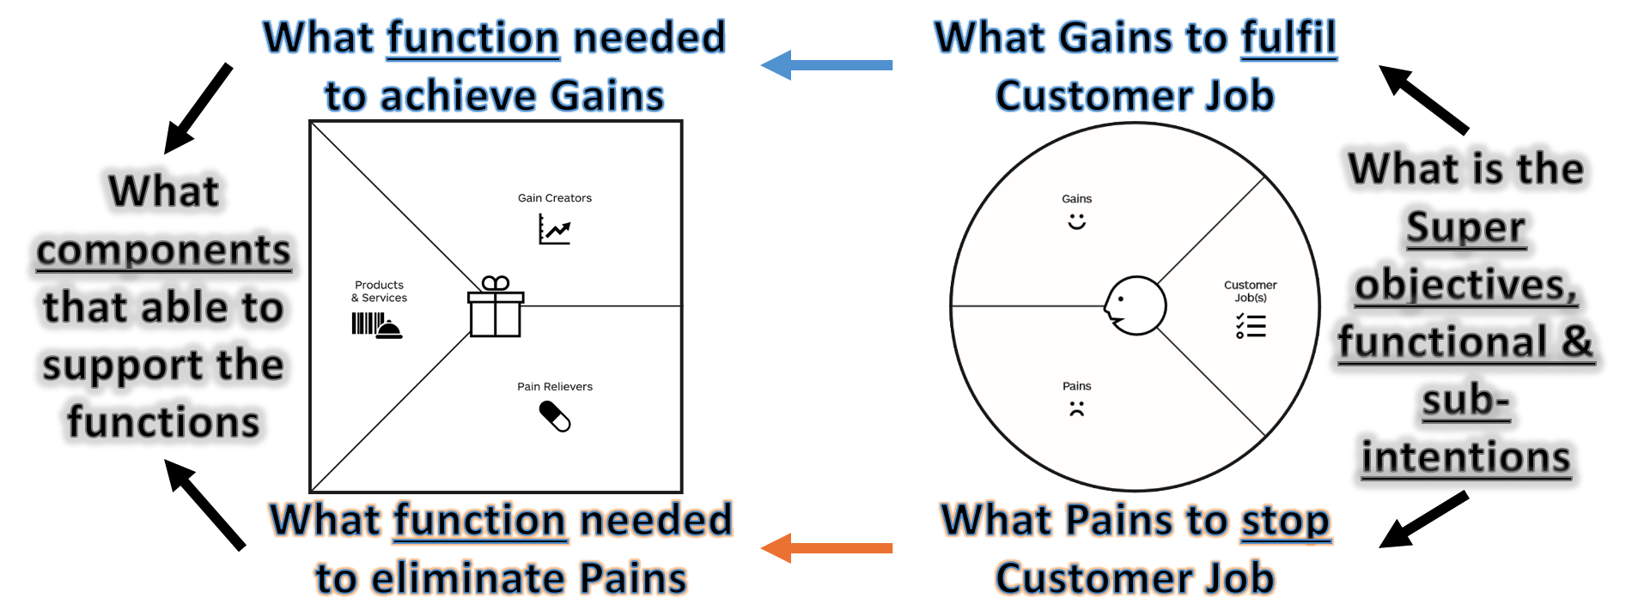
Assignment

Slide 3

Customer jobs
Functional
- Book transportation quickly
- Order food and groceries easily
- Pay cashless for services
- Track rides/deliveries in real-time
Social function
Appears tech-savvy and efficient
Support local gig economy
Choose eco-friendly rides (GrabGreen)
Emotional
Feel safe when commuting or sending family
Reduce stress during peak hours or bad weather
Trust that the app works every time
Picture of the existing product

Slide 4
Pains
Long Wait Times
Customers have to wait a long time for a ride
It led to frustration, inconvenience and may cause them to miss appointment or meals.
Surge Pricing
Prices go up significantly during high demand (e.g., rain, rush hour)
Makes customer feel the platform is expensive or unfair, especially for regular customer.
App Lag or Crashes
App occasionally freezes or crashes
It annoying the user but happens infrequently; customer may just restart the app

Slide 5
Pains reliever
Long Wait Times
The system uses AI to match users with the nearest available driver based on traffic, route efficiency and demand clusters.
Smart AI Dispatch System

Slide 6
Gains
Faster Ride and Delivery Times
Reduced wait time means rides and order arrive much quicker
Making the user experience smoother, more efficient and reliable during peak hours and emergencies
Improved Trust and Reliability
Users start to trust the app more because it delivers on time consistently find nearby drivers
Build long-term user loyalty and encourages them to keep using Grab over competitors
Better time management
Users can plan their day deter when they know rides won’t take forever
It adds value to the user’s daily routine but isn’t always critical feature.

Slide 7
Gains creator
Faster Ride and Delivery Time
The idea is to minimize the time users spend waiting for their rides or orders.
Optimizing how drivers or riders are assigned and positioned using AI.

Slide 8
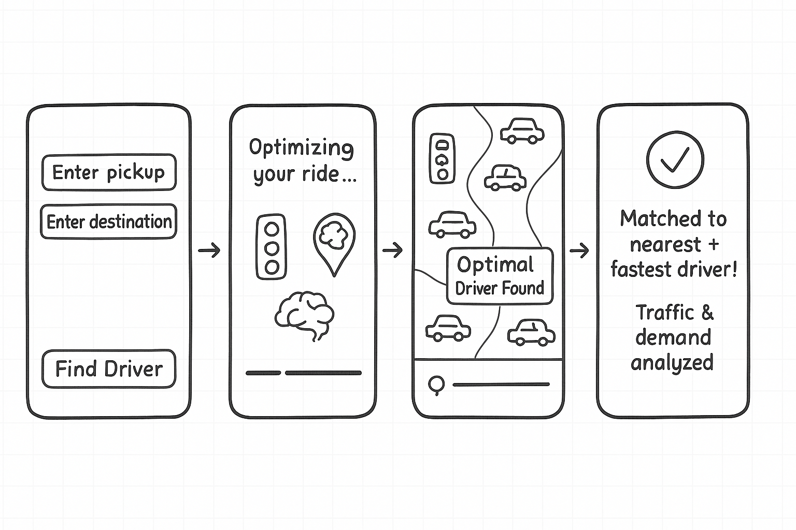
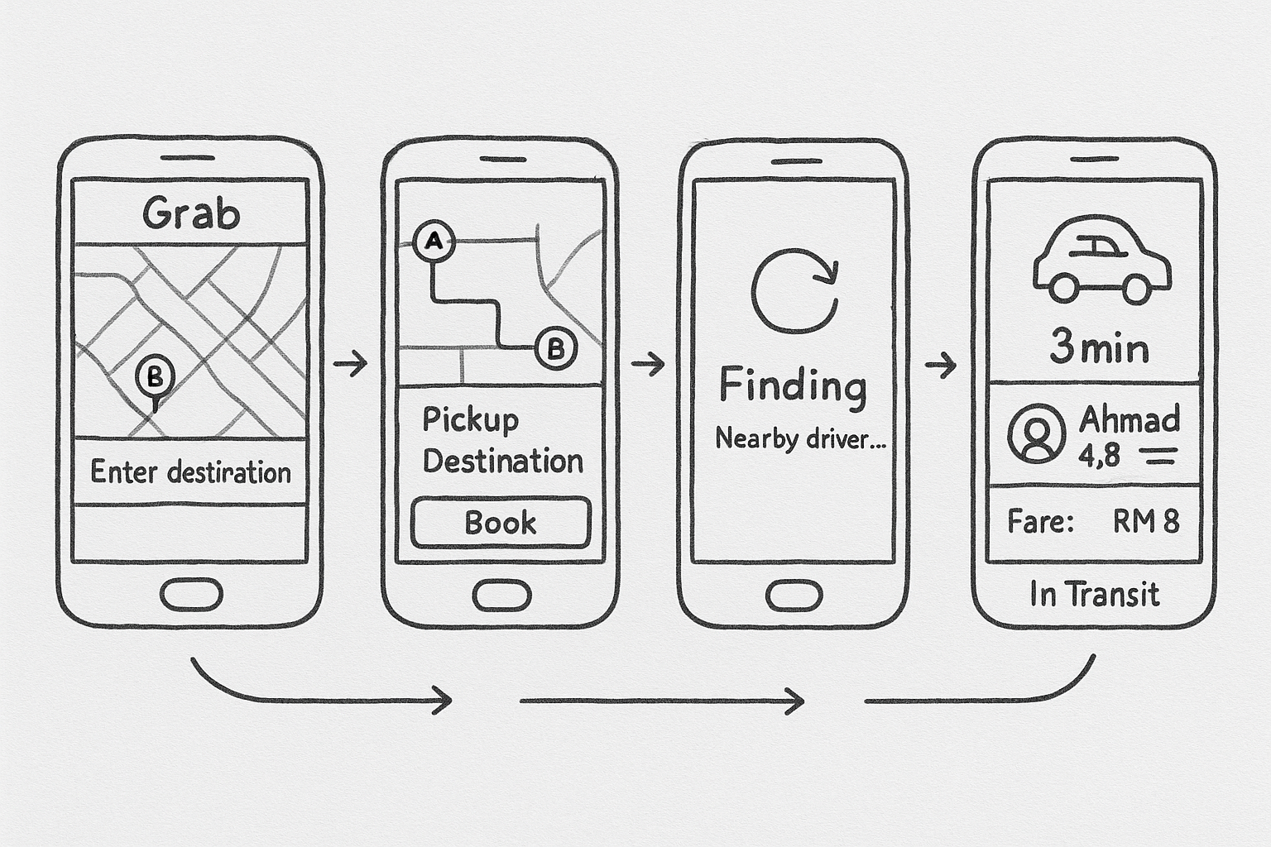
Proposal of the innovative solutions (Sketches)
Before VPC
After VPC
User matched randomly with a nearby driver.
No traffic or demand analysis.
Longer waiting times and inefficient routes.
AI analyzes real-time traffic and demand clusters.
Matches user with the nearest and fastest driver.
Shorter waiting times and smoother, more efficient rides.

Slide 9
End of Presentation Thank You Very Much

